Slide 1

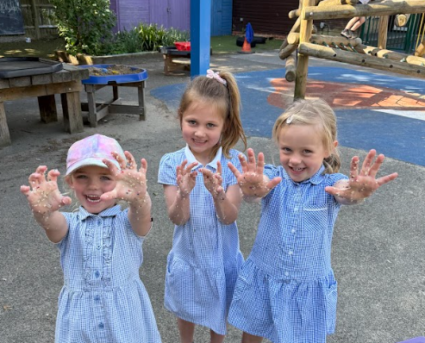
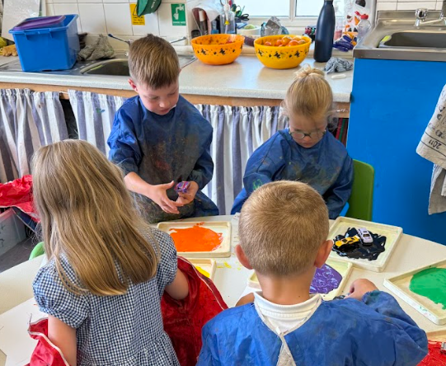
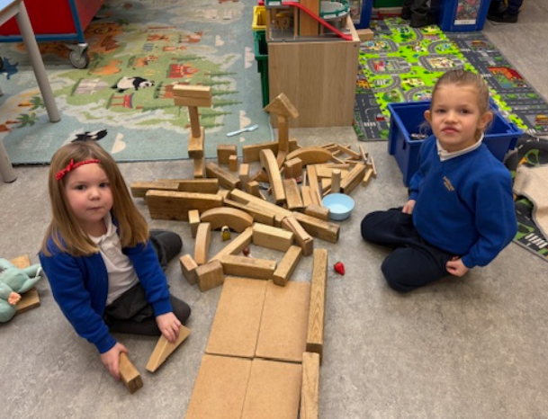
Hagbourne C.E. Primary School
Welcome Meeting
June 2025
Be the best you can be!

Slide 2
Key Staff:
Mrs Nicky Dobson - Headteacher
Mrs Sarah Jane Lewis – Deputy Head
Mrs Caroline Dendy – Class Teacher
Mrs Caroline Coles - Teaching Assistant
Mrs Jo Hudson - SENDCo
Miss Katie Gilbert - School Business Manager
Mrs Sammy McIntyre – Office Administrator

Slide 3
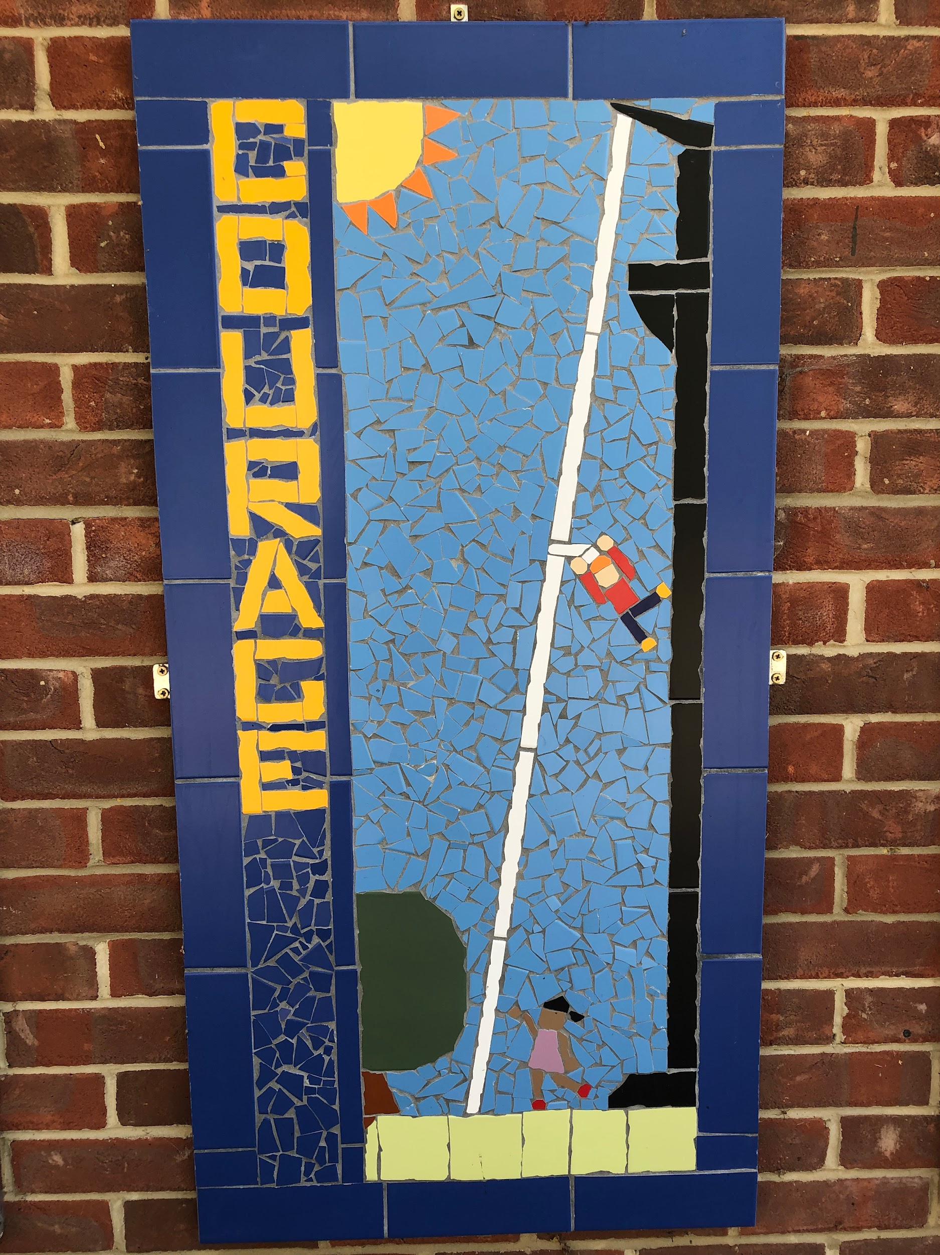
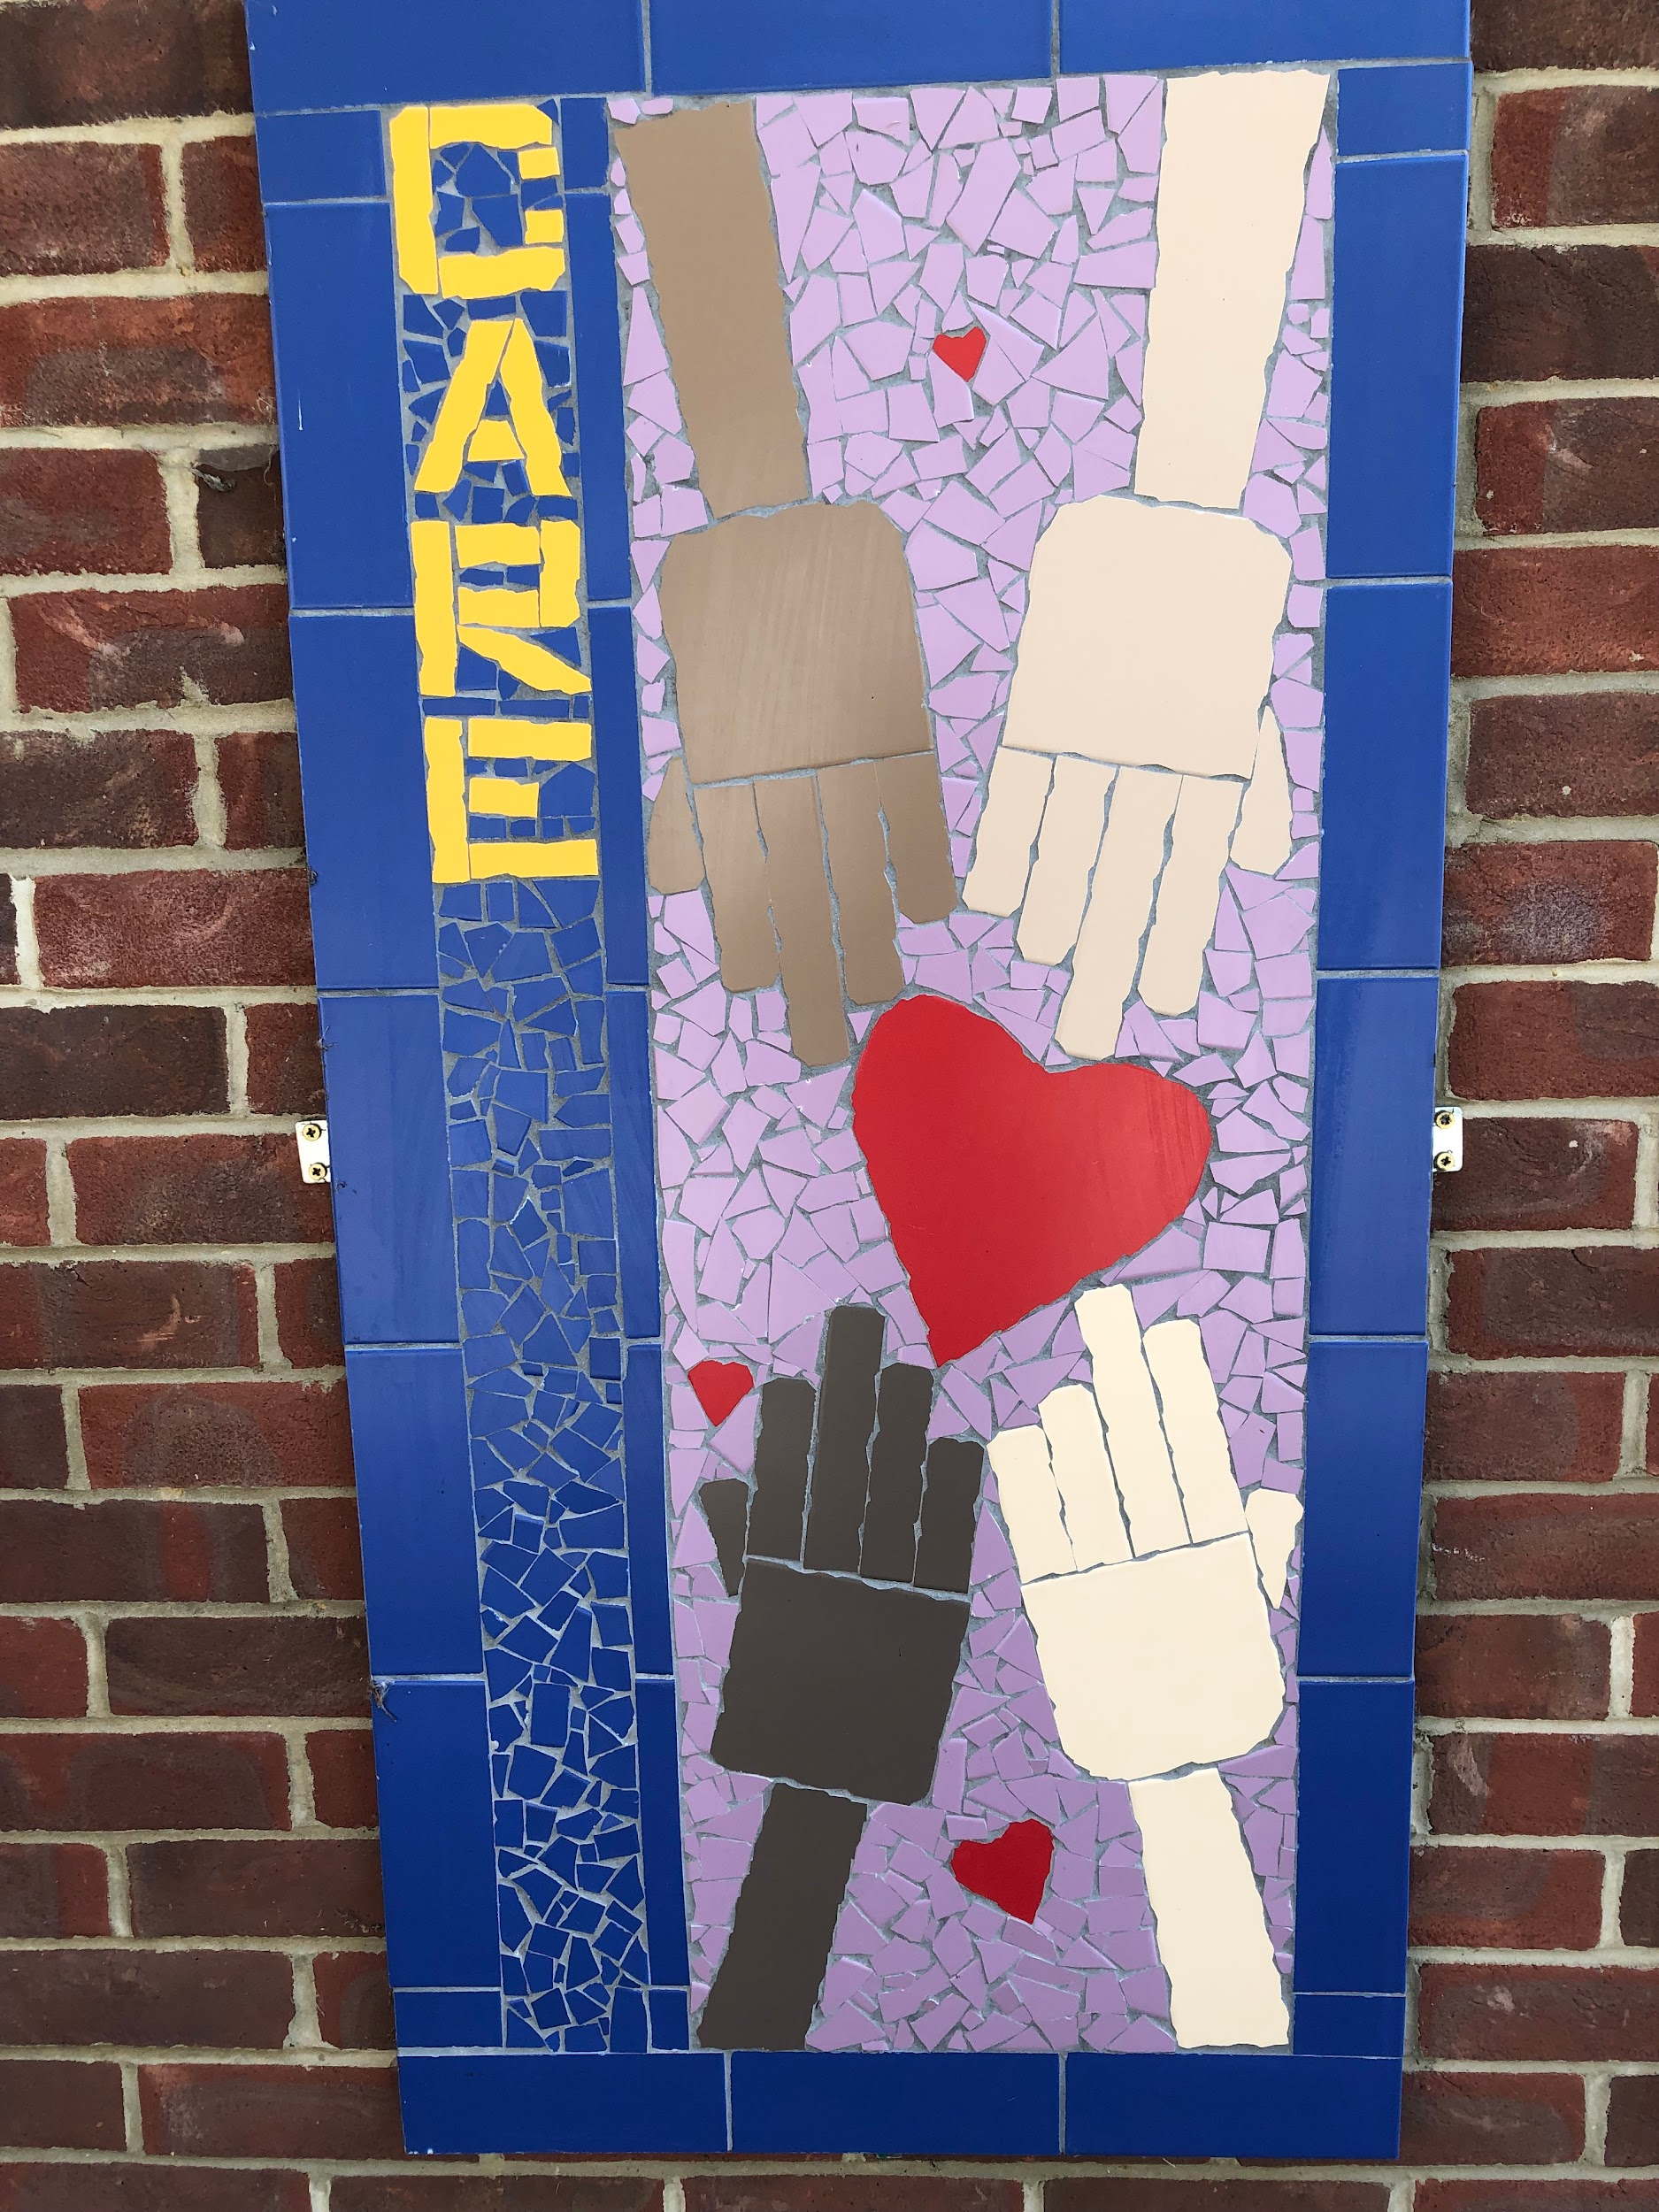
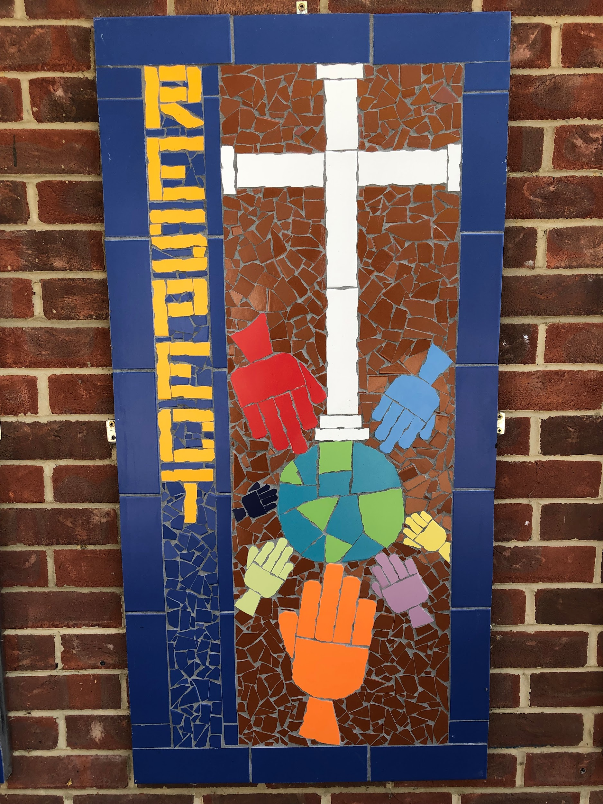
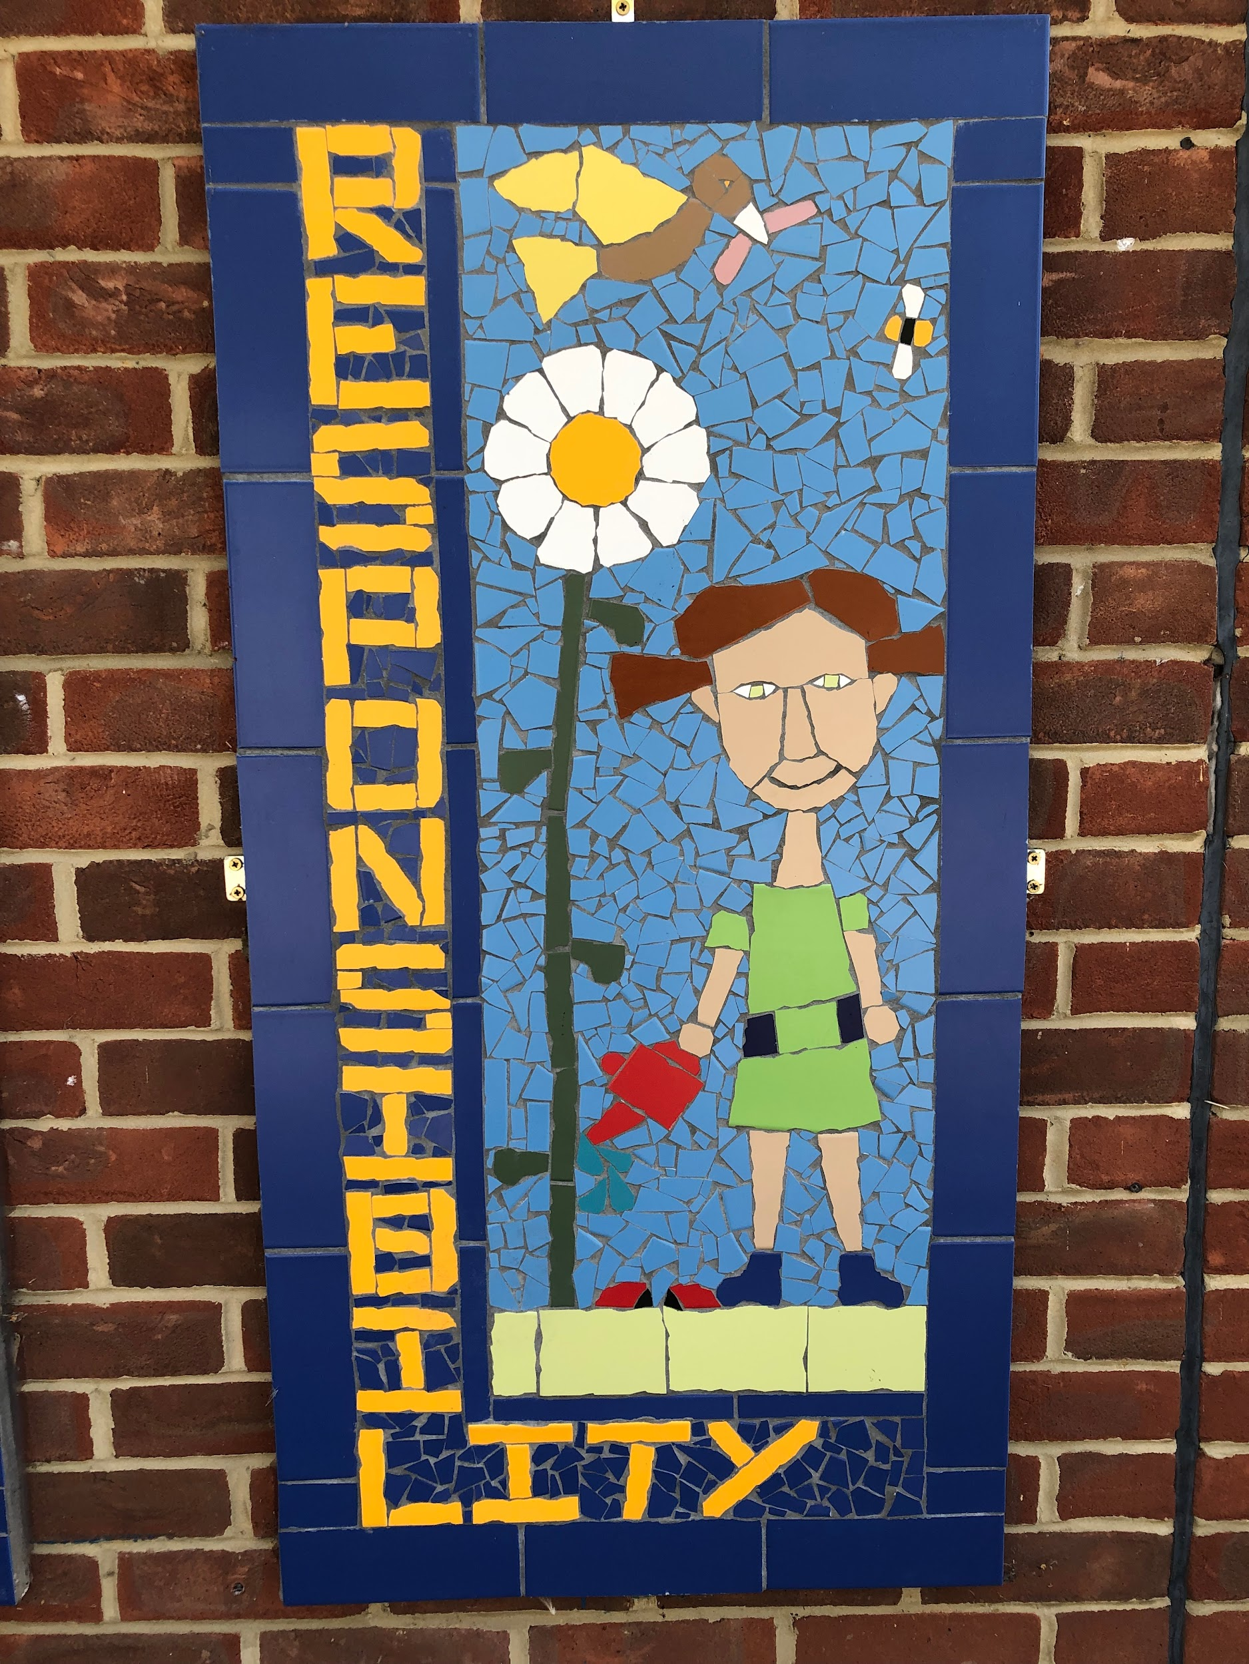
Vision
‘Be the best you can be’
Values
Following the example of the story of the Good Samaritan, we get our Christian values of courage, care, respect and responsibility. We are an inclusive school, serving all faiths or none.

Slide 4
WE AIM TO:
Build on our Christian foundations to provide a secure and safe environment where children are nurtured;
Establish a happy, well-ordered and stimulating environment for staff and children to work within;
Provide the highest quality education through a stimulating, broad and balanced curriculum with the right amount of challenge and support;
Value every member of the school community, build self-esteem and recognise that everyone has strengths;
Encourage children to recognise their own potential by developing effective learning strategies;
Promote respect for others, the environment and the wider world;
Encourage children to take responsibility for their own learning by developing good working habits and encourage an enquiring mind;
Support children to have the courage to try new things, learn by taking risks, develop resilience and make positive choices;
Nurture children to become caring individuals, to care for themselves and others;
Value the role of parents as partners in the learning process;
Ensure that there is equal access and opportunity for all pupils;
Support all staff by providing opportunities for their professional development;

Slide 5
A Typical Day in Reception
Doors open at 8.35am
Teachers welcome parents and child at the gate
Hang up coats outside, parents then leave and TAs escort the children inside
Children put away drinks and book bags in drawers and activities are set up to explore
Children come to the carpet for register at 9am with a focused phonics session until around 9.30. As the year progresses, this will increase.
Exploring time until 10.30
Snack time is from 10.30-10.45
Playtime is from 10.40- 10.55am
Maths activities are run from 11-11.45
Lunchtime is 11.50 – 1.00pm.
1pm- relaxation
1.15pm- Drawing Club
Exploring time until 2.30pm
Hometime 3.15pm
A typical day involves some whole class, adult focused, adult directed and self initiated learning during ‘exploring time’.
All parents will be asked to sign up for a Tapestry account to share in their children’s learning journey
A typical day

Slide 6
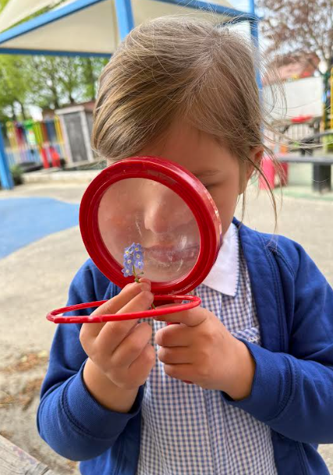
Early Years Foundation Stage Curriculum:
We plan using the legal document called the EYFS Framework.
Statutory for all children from birth to age five
Supports learning and development through play, exploration and real-life experiences
In Reception, the EYFS continues strong foundations for a lifelong love of learning- focusing on the whole child, not just academics!
The 7 Areas of Learning
Communication and Language
Physical Development
Personal, Social and Emotional Development
Literacy
Maths
Understanding the World
Expressive Arts and Design
Class page
Tapestry

Slide 7
Induction programme:
Term 6
Open afternoons: during June, you are invited to attend school for an
hour on a Wednesday or Thursday afternoon between 1:30-2:30pm. You
will need to stay with your child during the visit. This is an opportunity for the children to visit the school/classroom and for you/them to meet the staff. You need to call the school office to book in your visit. If your child is on the SEND register and you feel your child needs extra sessions, please contact the school office.
Transition afternoon: Tuesday 9th July 1:15-2:45pm
All children across the school will be visiting their new classes/teachers on this day. Please drop your children off and collect them from the Reception gate
Term 1: September
Home visits:
  Home visits will only be offered to any families who are new to the school
  The home visits will take place on Tuesday 3rd September and Wednesday 4th September
This will give you and your child a chance to ask any questions.
Visits are limited to 10 mins.

Slide 8
Planned transition for Reception children
September 2025
Monday 1st September | INSET DAY – School Closed
Tuesday 2nd September | INSET DAY - School Closed Home Visits – all day for any families new to the school
Wednesday 3rd September | Morning - 8.35am – 11.45am
Thursday 4th September | Morning with lunch - 8.35am – 1.15pm
Friday 5th September | FULL TIME IN SCHOOL BEGINS- 8.35am to 3.15pm

Slide 9
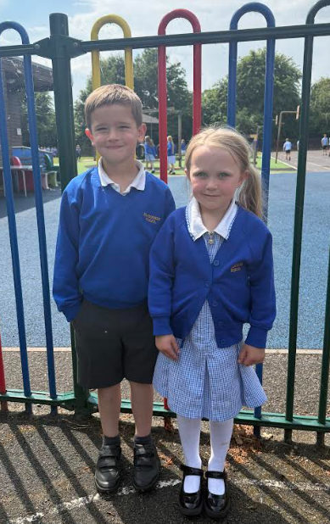
Uniform
Summer
Plain white polo shirt
Navy tracksuit bottoms/leggings
Navy shorts OR grey school shorts
OR mid-blue checked summer dress
Plain white, grey or black socks
Black shoes (not trainers, boots, high heels or sandals)
Winter
Navy jogging bottoms/leggings OR grey trousers,
skirt/culottes or pinafore dress
White polo shirt
Royal blue jumper* or cardigan* with the school name
Grey, black or white socks or tights
Black shoes (not trainers, boots or shoes with high heels)
Uniform and book bag available from Trutex on Cockroft Road

Slide 10
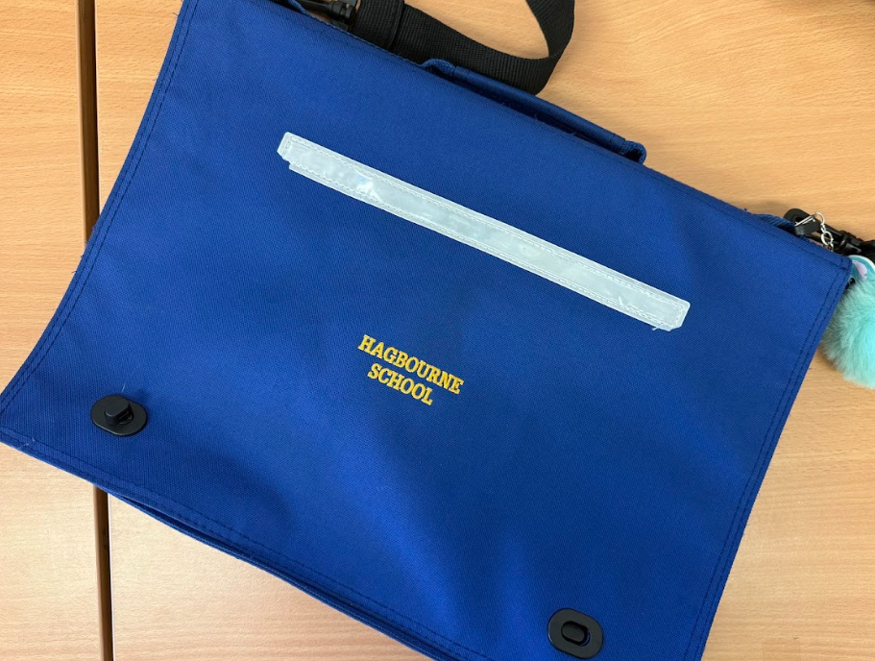
Other important things!
Water bottle
Book bag (no backpacks please)
PE Kit (after October half-term)
Swimming Kit (summer term)
Name EVERYTHING!

Slide 11
Term dates for 2025-2026
Autumn Term: Monday 1st September to Friday 19th December
INSET day: Monday 1st September
INSET day: Tuesday 2nd September
INSET day: Friday 3rd October
Half Term Holiday: Monday 20th October to Friday 24th October
Christmas Holiday: Monday 22nd December to Friday 2nd January
Spring Term: Monday 5th January to Friday 27th March
INSET day: Monday 5th January
Half Term Holiday: Monday 16th February to Friday 20th February
Easter Holiday: Monday 30th March to Friday 10th April
Summer Term: Monday 13th April to Monday 20th July
Bank Holiday: Monday 4th May
INSET day: Monday 1st June
INSET day: Monday 20th July
Half Term Holiday: Monday 25th May to Friday 29th May

Slide 12
Other useful information:
Universal Free School Meals – every child from Reception to Year 2 is entitled to a free hot meal (see website for menu).
Snack/drink - a piece of fresh fruit is provided each day for your child and a drink of milk or water. Water will be readily available throughout the day.
Packed Lunch – please ensure they are healthy and balanced and no nuts including peanut butter or hazelnut chocolate spread or houmous
Holidays - we are unable to authorise holidays during term time. Permission to take your child out of school during term time will only be granted if there are exceptional circumstances.
Governors - meet at least once a term. They are responsible for the smooth running of the school and assist the Headteacher in policy-making decisions. Governors can be contacted through school.
Home - School reading records where parents and staff can record
reading

Slide 13
Other useful information:
Sickness or diarrhoea – 48 hours off school. Any illness you must ring the school by 8.30am so we can inform teachers.
Breakfast Club and After School Club - there will be some spaces so please make sure you have returned the form to the school office
There will be plenty on offer for you to get involved with your child’s education. This includes workshops/meetings on specific things to help you support your children at home eg. phonics information evening
PTA are very active and keen for new members!

Slide 14
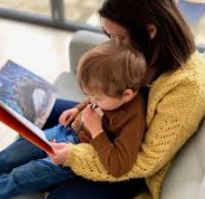
How Can I Help at Home?
Talk lots. Chat, ask questions and let your child respond in their own way
Read together every day. Make is a calm, enjoyable moment- repetition is good!
Encourage independence. Let them zip coats, help tidy, butter toast.
Play together. Follow their lead in play. Join in their world- pretend, build, explore.
Follow their interests. If they love bugs, dinosaurs, cooking- lean in!
Praise the effort. Celebrate persistence and curiosity: ‘You didn’t give up- that’s amazing!’
50 things to do before you’re 5!
https://startingreception.co.uk/

Slide 15
Any questions?

